Slide 1

Bike-Sharing Demand
Shril Patel
March 3, 2025

Slide 2
Outline
Executive Summary
Introduction
Methodology
Conclusion
Results
Appendix

Slide 3
Executive Summary
Rising Importance of Bike Sharing:
Over the past few decades, bike sharing has become increasingly significant as more people seek healthier and more livable cities where such activities are readily accessible.
Prediction of bike rental:
We discovered that a polynomial model with more terms and interactions, achieved the best performance.
Key factors include temperature, rainfall, humidity, peak hour, and weekdays, indicating weathers significant impact on bike rentals.
Dataset Overview:
The Dataset encompasses weather information (including temperature, humidity, windspeed, etc.). Hourly bike rentals counts, and date details for the capital bike share system from 2017 to 2018.

Slide 4
Introduction
Problem Defining:
It is important for each of these cities to provide a reliable supply of rental bikes to optimize accessibility at all times.
Solid Background:
The global bike sharing cities dataset is an HTML table on the Wikipedia page list of bicycle-sharing systems.
Supportive Tool:
The open Weather API allows users to access current and forecasted weather data for any location including over 200,00 cities.
The Goal:
Minimizing program costs, including bike supply to meet demand, is important. Predicting hourly bike needs based on weather helps optimize supply.

Slide 5
Methodology
Perform Data Collection
Perform Data Wrangling
With Regular Expressions
With dplyr
Perform exploratory data analysis (EDA) using SQL and visualization
Perform predictive analysis using regression models
How to build baseline model
How to improve the baseline model
Build a R Shiny dashboard

Slide 6
Methodology

Slide 7
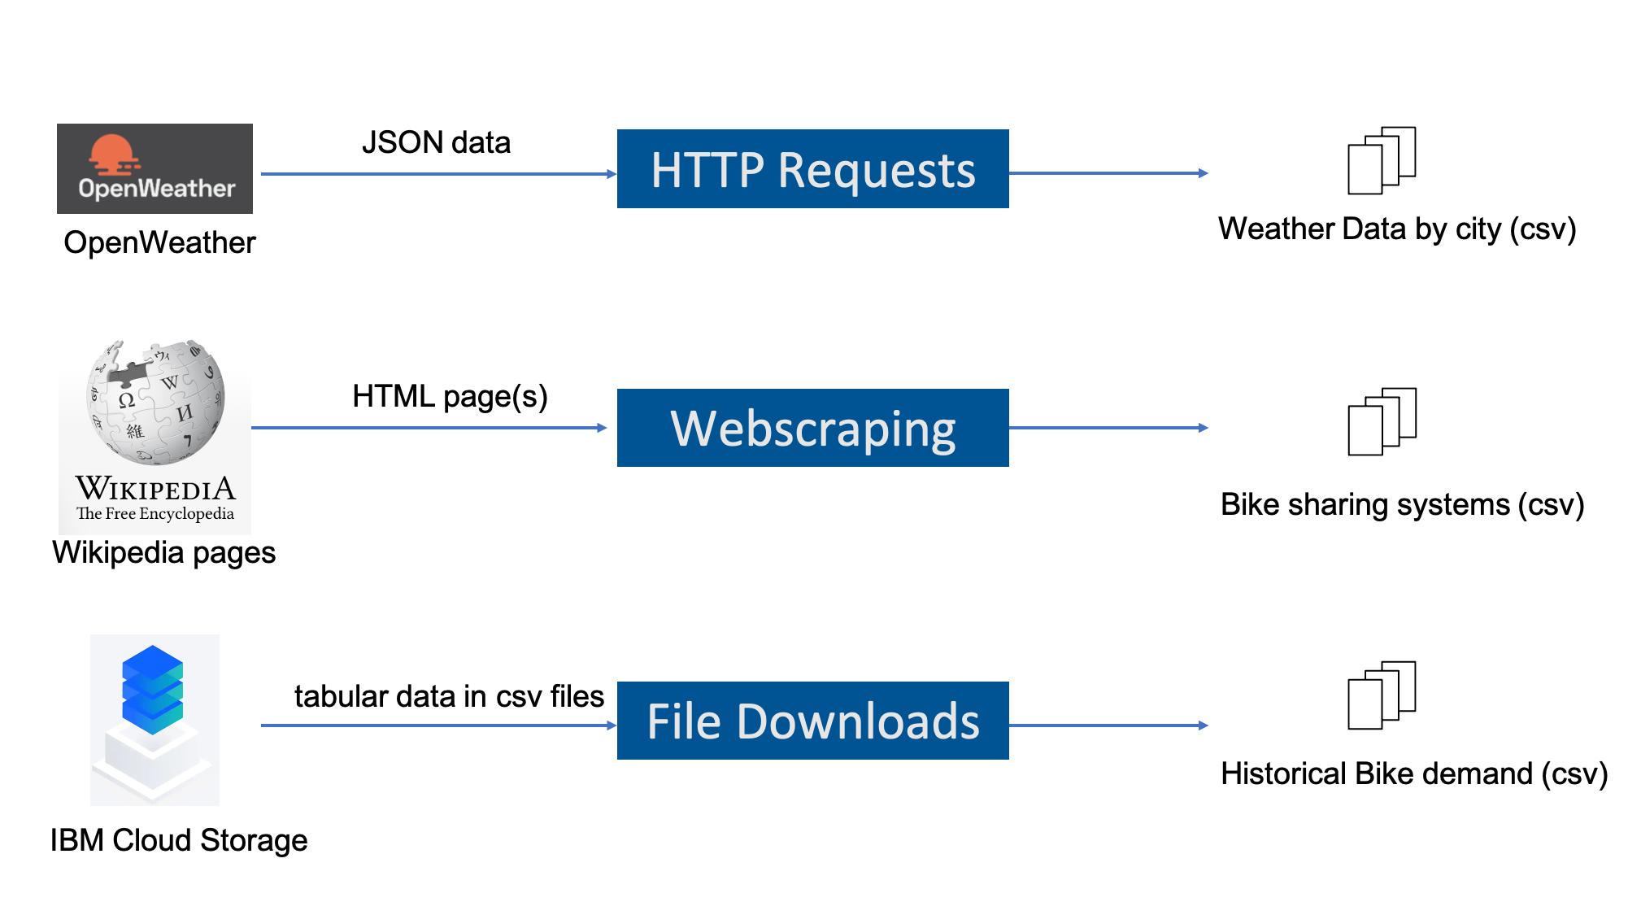
Data Collection
5-day weather forecast for a list of cities from OpenWeather API.
Global Bike Sharing Systems Dataset which is an HTML table on the Wikipedia page list of bike-sharing systems: URL. It lists active bicycle-sharing systems around the world.
World Cities Data which contains information such as name, latitude, and longitude, about major cities around the world.
The Seoul Sharing Demand Data set which contains weather information (Temperature, Humidity, Visibility, Dewpoint, Solar radiation, Snowfall, Rainfall), and the number of bikes rented per hour and date

Slide 8
Data Wrangling
This stage involved cleaning the data by checking for missing values, mis-formatted values and/or unexpected noises.
The first step involved the use of the R package ‘string’ and regular expression language to standardize column names, remove unwanted reference links from tables and extract numeric values from rows.
The next step involved the use of the ‘dplyr’ package to detect and handle missing value in the data tables, create indicator (dummy) variable for categorical variables, and normalize the data using min-max normalization.
Raw Data
Regular
Expressions
~Standardization of column names
~Removal of undesired reference links
~Extraction of numeric values
Raw Data
DPLYR
~Detection and handling of missing values
~Creation of indicator variables for categorical variables
~Data Normalization

Slide 9
EDA with SQL
Exploratory Data Analysis was performed on the datasets using Structured Query Language (SQL). The queries performed to;
Determine how many records are in the seoul_bike_sharing dataset.
Determine how many hours had non-zero rented bike count.
Query the weather forecast for Seoul over the next 3 hours.
Find which seasons are included in the Seoul bike sharing dataset.
Find the first and last dates in the Seoul bike sharing dataset.
Determine the date and hour had the most bike rentals.
Determine the average hourly temperature and the average number of bike rentals per hour over each season. List the top ten results by average bike count.
Find the average hourly bike count during each season.
Determine the average TEMPERATURE, HUMIDITY, WIND_SPEED, VISIBILITY, DEW_POINT_TEMPERATURE, SOLAR_RADIATION, RAINFALL, and SNOWFALL per season.
Determine the Total Bike Count and City Info for Seoul.
Find all city names and coordinates with comparable bike scale to Seoul’s sharing systems.

Slide 10
EDA with Data Visualization
Exploratory Data Analysis was also performed to visually inspect dataset using the ggplot2 library. The ggplot2 library was used;
Create a scatter plot of ‘RENTED_BIKE_COUNT’ vs ‘DATE’
Create the same plot of the ‘RENTED_BIKE_COUNT’ time series, but now add ‘HOURS’ as the color.
Create a histogram overlaid with a kernel density curve.
Create a scatter plot to visualize the correlation between ‘RENTED_BIKE_COUNT’ by ‘SEASONS’
Create a display of four boxplots of ‘RENTED_BIKE_COUNT’ vs. ‘HOUR’ grouped by ‘SEASONS’.

Slide 11
Predictive Analysis
This stage involved building and refining a regression model to predict the number of bikes that would be rented at each hour of the day by factoring in weather and non-weather conditions.
The cleaned and processed data is divided into two sets: Train set (for model creation and refinement via polynomial regression, interaction, and regularization) and Test set (for Model Evaluation). The constructed models were evaluated using RMSE and RSQ as our assessment metrics, and the regression algorithm was chosen based on the lowest RMSE and highest RSQ values.
Input Data
Train/Test Split
Train Data
Test Data
Model Evaluation (RSQ &RMSE)
Polynomial Regression Interaction Terms Elastic Net Regulation
Best Model Selection

Slide 12
Build a R Shiny Dashboard
The results of the predictive linear regression model were combined with an interactive dashboard created using the shiny package in R. This dashboard contained;
A basic max bike prediction overview map.
A static temperature trend line.
An interactive bike-sharing demand prediction trend line.
A static humidity and bike-sharing demand prediction correlation plot.

Slide 13

Results
Exploratory Data Analysis Results
Predictive Analysis Results
A dashboard demo in screenshots

Slide 14
EDA with SQL

Slide 15
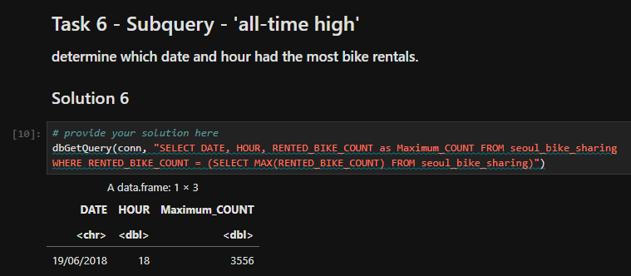
Busiest Bike Rental Times
On June 19, 2018, at 6:00pm, the highest number of bike rentals in Seoul was recorded.

Slide 16
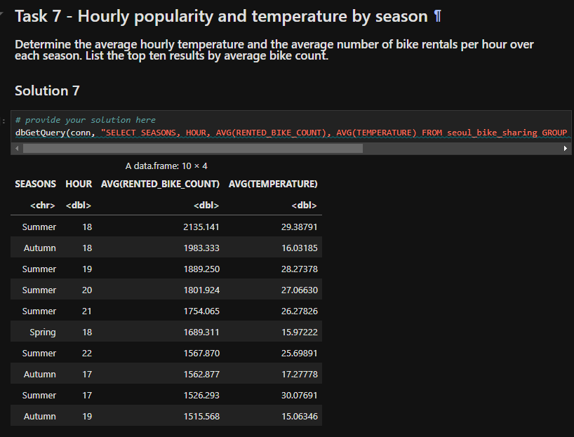
Hourly Popularity and Temperature by Seasons
The result of the query showed that more bikes were rented during Summer, Autumn or Spring, between the hours of 5pm and 10pm and at temperatures between 15 degrees Celsius and 30 degrees Celsius which are typical Autumn, Summer and Spring temperatures.

Slide 17
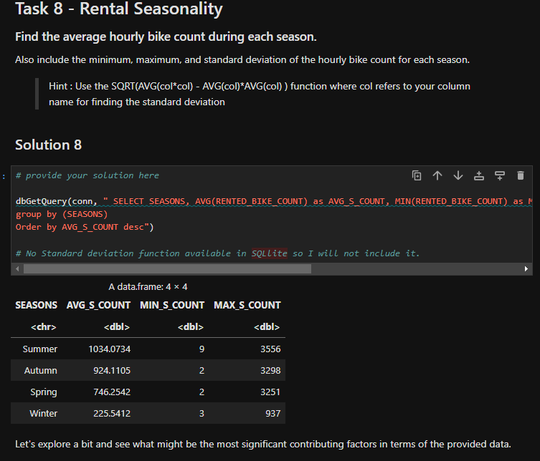
Rental Seasonality
The result of the query showed that on average more bikes were rented during Summer and fewer bikes were rented during Winter

Slide 18
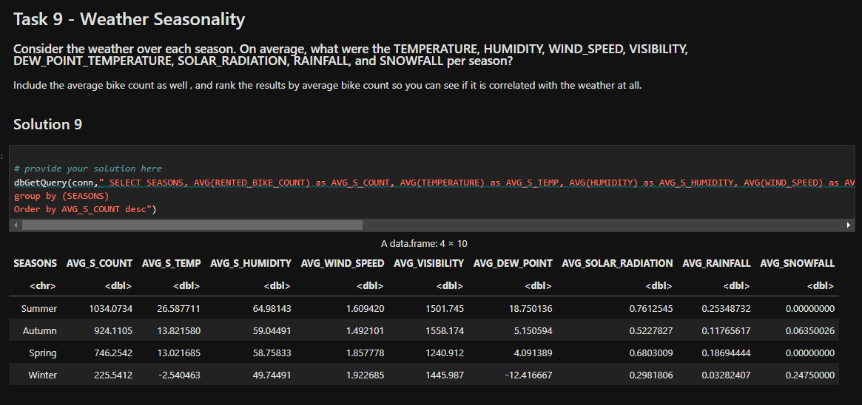
Weather Seasonality
The results showed that the temperature, rainfall, humidity, snowfall, etc. readings were very correlated with the season of the year. For example, there was a higher average temperature and rainfall in the summer, while snowfall was confined to the winter season. It also showed a correlation between the number of rented bikes and the season of the year.

Slide 19
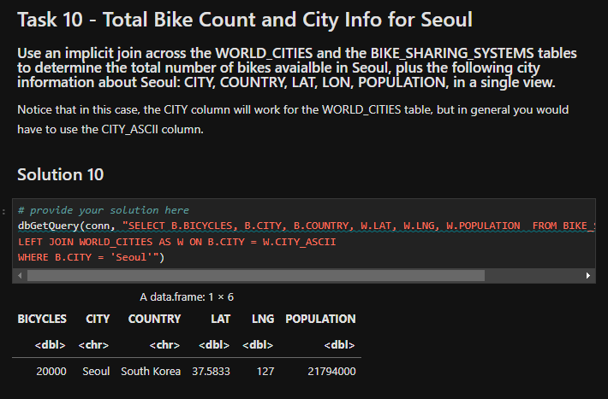
Bike-Sharing Info in Seoul
The result of the query showed that there were 20,000 bikes available for rent in the city of Seoul.

Slide 20
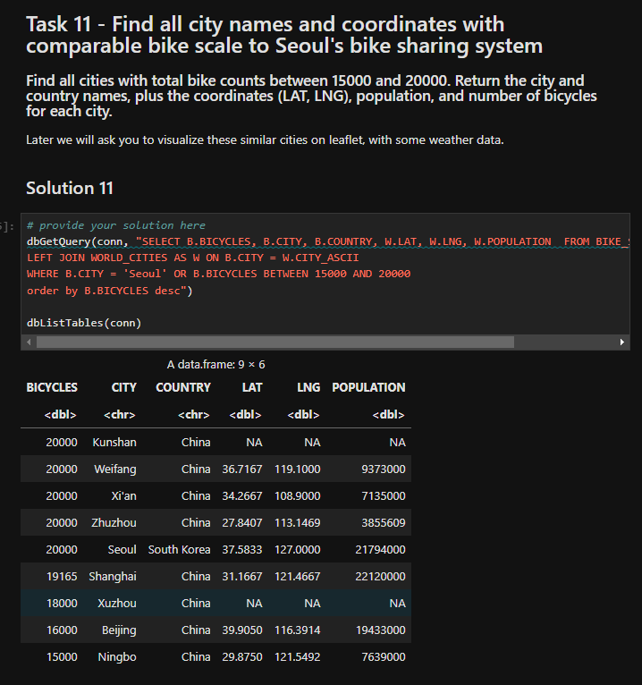
Cities Similar to Seoul
The result of the query showed that six cities in China namely; Zhuzhou, Xi’an, Weifang, Shanghai, Beijing and Ningbo had similar number of rental bikes like Seoul.

Slide 21
EDA with Visualization

Slide 22
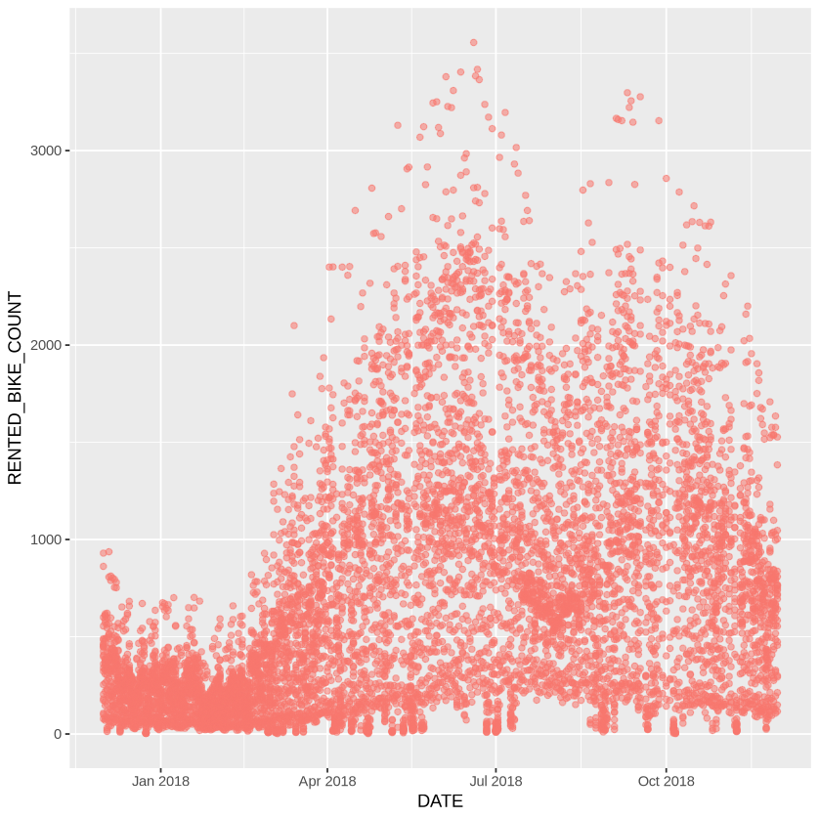
Bike Rental Vs. Date
The number of bicycle rentals starts to rise in the spring and peaks in the summer months of June and July. We also observe a slight decline in August as the season draws to a close, followed by another high in September. The number of hired bikes also gradually declines as the winter months approach as we approach the conclusion of the year

Slide 23
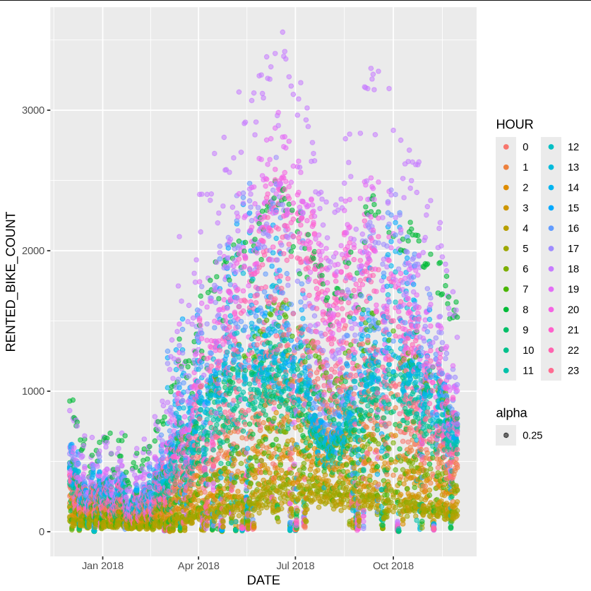
Bike Rental Vs. Datetime
The largest hourly bike rentals are observed between the hours of 6pm and 7pm. In the mornings around 7 a.m., we also observe a moderate to high volume of bike rentals. Generally, more bike rentals occur during the day, and this pattern continues throughout the year.

Slide 24
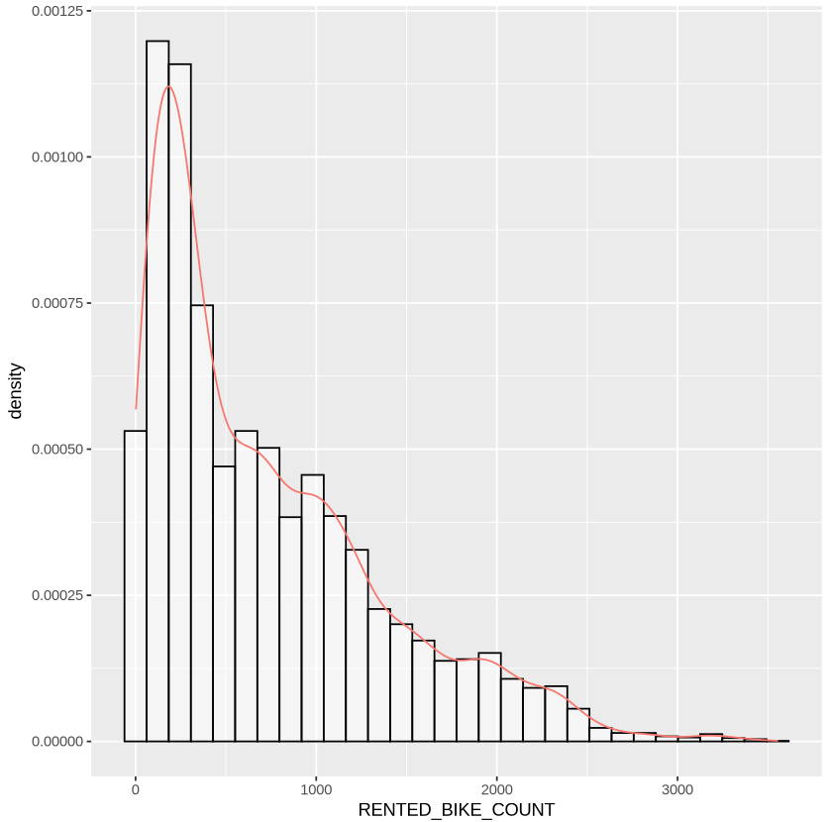
Bike Rental Histogram
It also demonstrates that rental bike counts ranging from 0 to 500 occur most frequently in the sample. The 'mode,' or most often rented number of bikes, is about 250. Because the density curve is tilted to the left, the mean is smaller than the median.

Slide 25
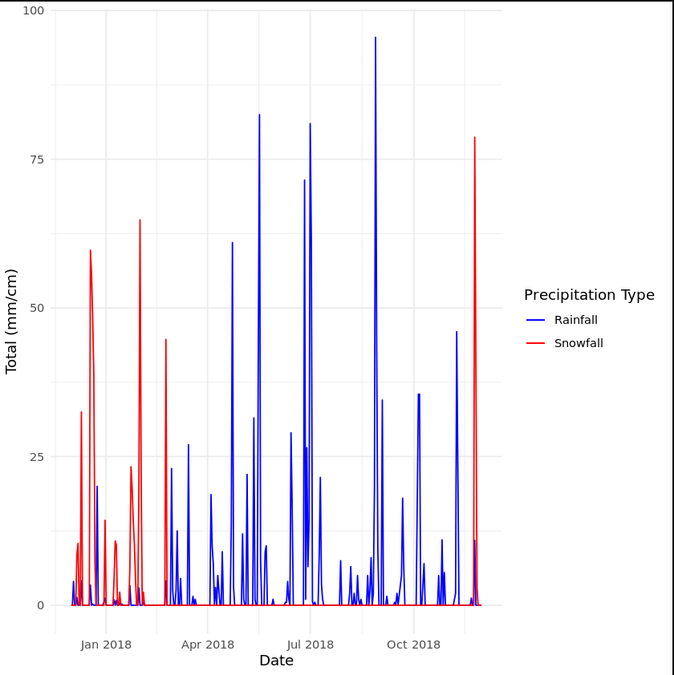
Daily Total Rainfall & Snowfall
Snowfall primarily occurs during winter days. Rainfall occurs almost year-round, with its main peaks in June, July, and September

Slide 26
Predictive Analysis

Slide 27
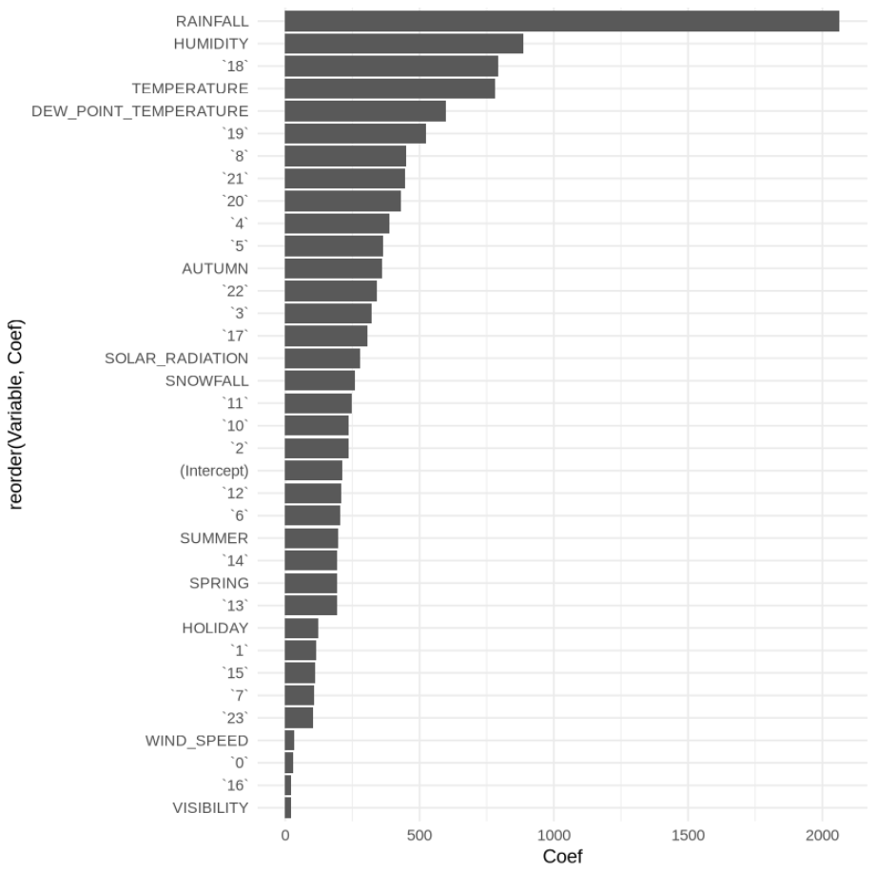
Ranked Coefficients
Rainfall, humidity, the 6 PM temperature, and overall temperature are the strongest predictors of bike rentals.
Rainfall and humidity make biking less comfortable and practical.
Temperature, especially at 6 PM—a key time for commuting and leisure—encourages biking when conditions are favorable. Together, these factors highlight the influence of weather on outdoor activity preferences.

Slide 28
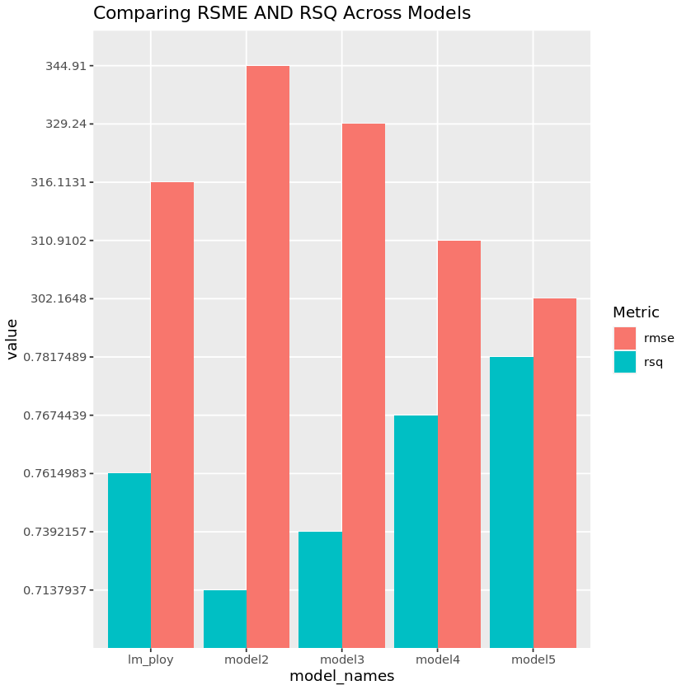
Model Evaluation
The Root Mean Squared Error (RMSE) and R Squared (RSQ) metrics were used to assess the performance of each model. The bar charts on the right show the RMSE and RSQ performance of all models.

Slide 29
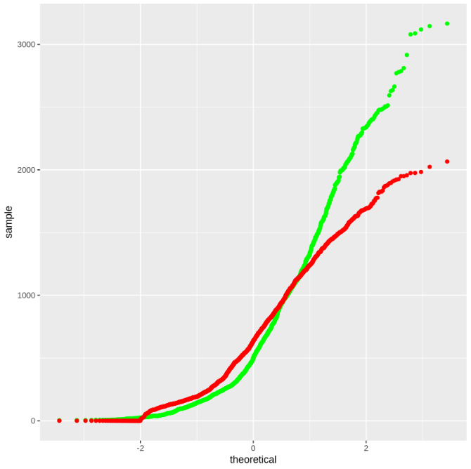
Q-Q Plot of the Best Model
Q-Q plot of the best model’s test results vs the truths

Slide 30
DashBoard

Slide 31
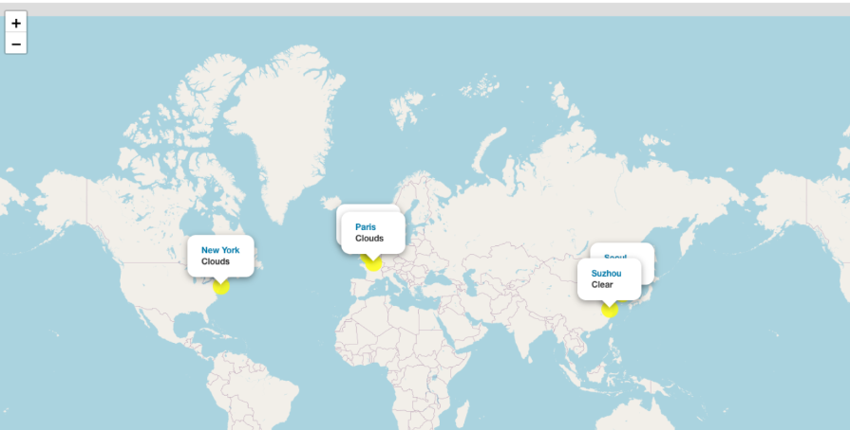
Global Bike Demand Prediction
Map of predicted bike demand for the cities of Seoul, Suzhou, London, New York and Paris.

Slide 32
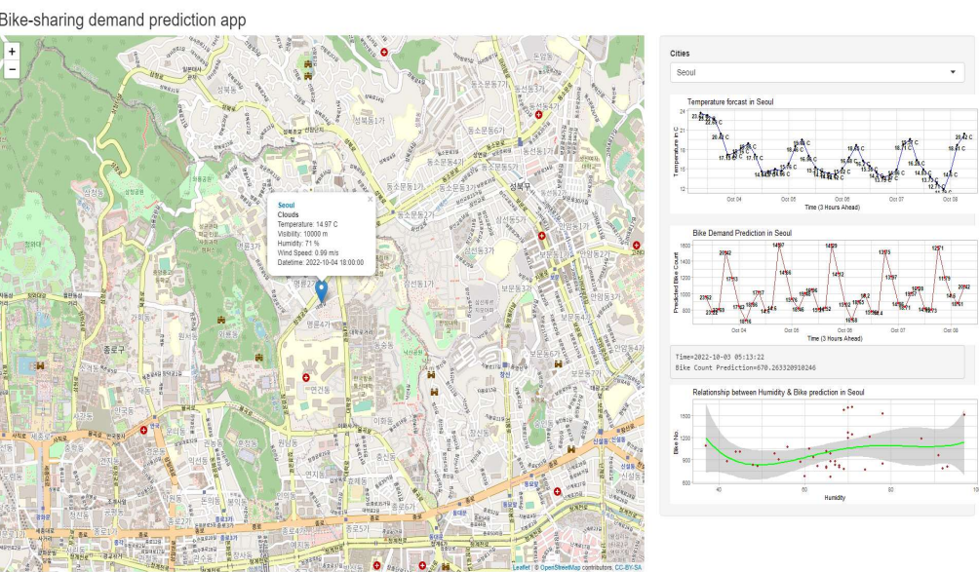
Dashboard City View: Seoul
The following screenshot displays Seoul’s temperature forecast and bike demand forecast. However, the impact of humidity on predicted bike demand is missing due to technical reasons.

Slide 33
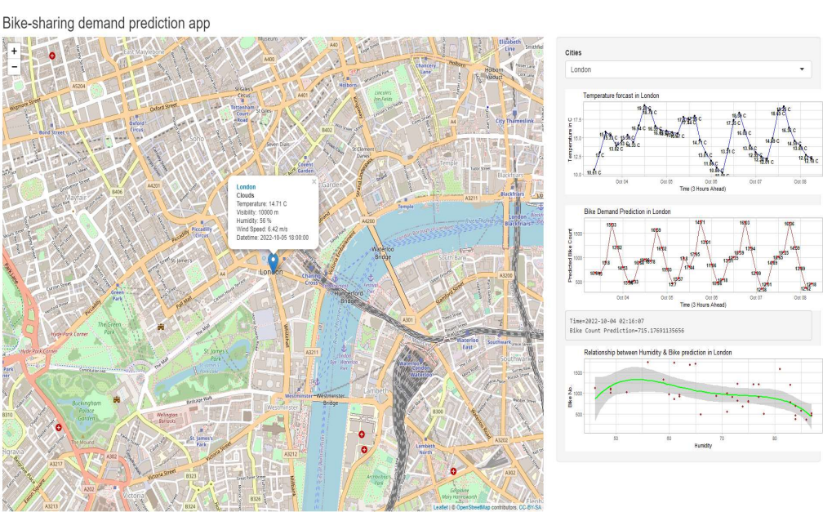
Dashboard City View: London
The following screenshot displays London’s temperature forecast, bike demand forecast, and the impact of humidity on predicted bike demand.

Slide 34
Conclusion
The summer months of June and July saw the biggest demand for bike sharing.
During the day, the peak demand for rental bikes is between 6 and 7 p.m.
During the winter, there is virtually little demand for bicycles.
The quantity of bikes hired throughout each hour of any given day is heavily influenced by temperature and humidity.

Slide 35
Appendix
Web Scrapping
OpenWeather API
Data Wrangling – Regular Expression
EDA – SQL
EDA with Visualiztion

Slide 36
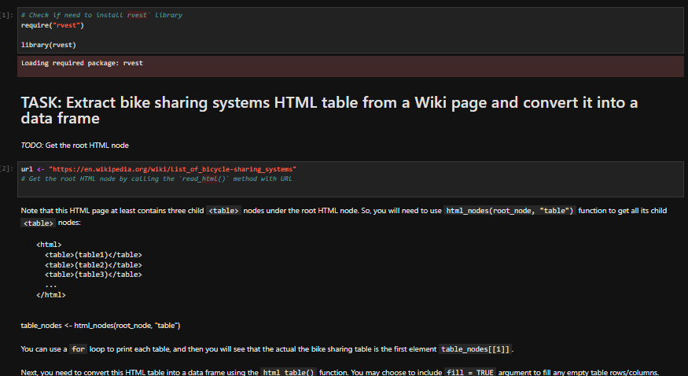
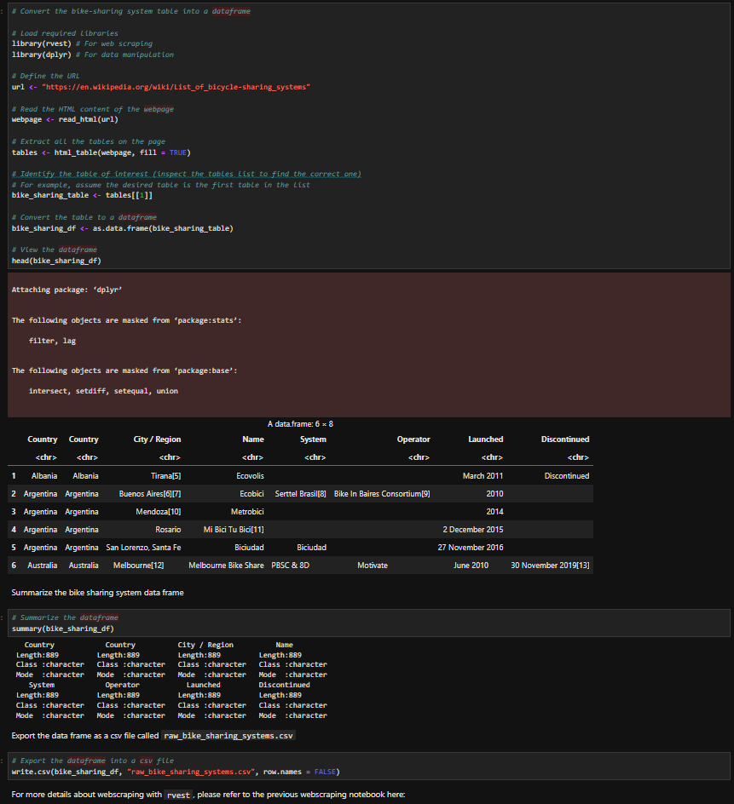
Appendix: Web Scrapping

Slide 37
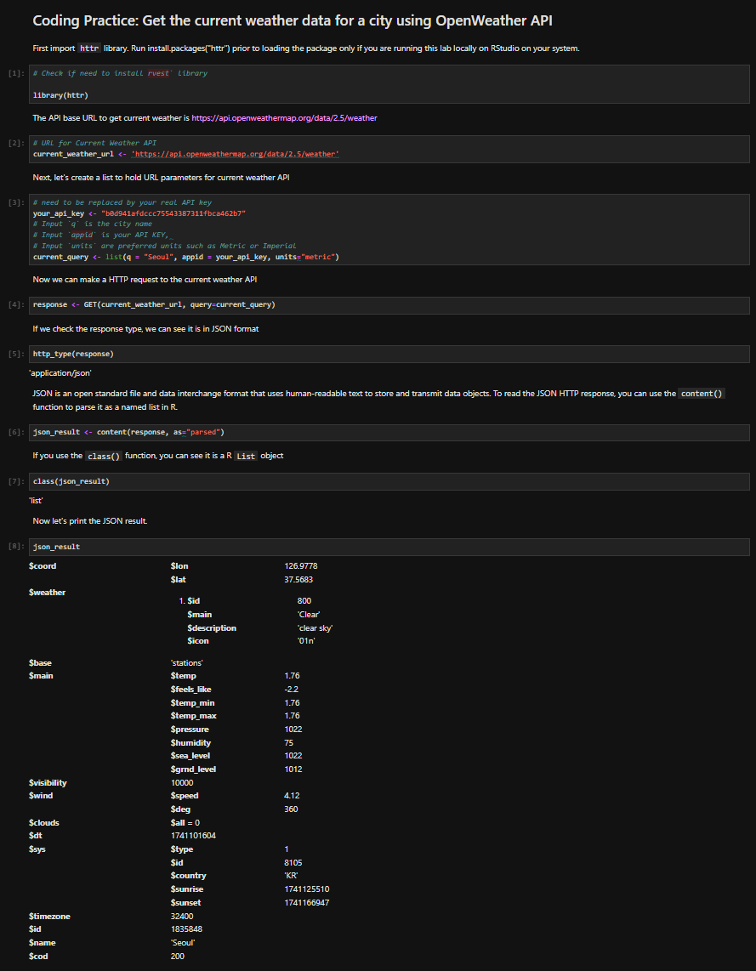
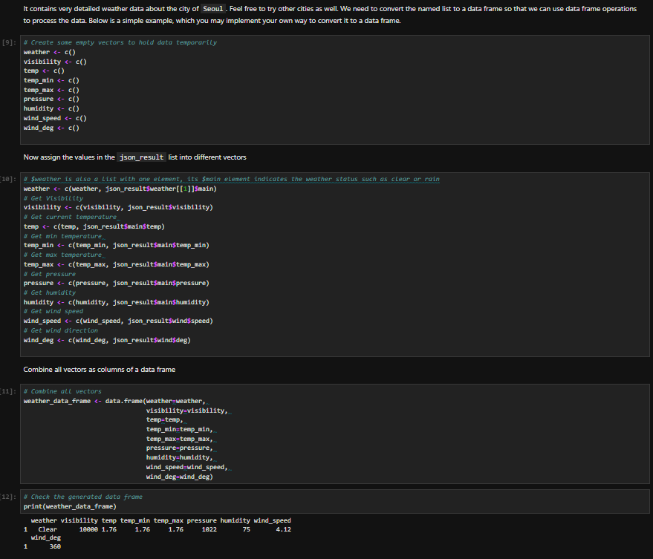
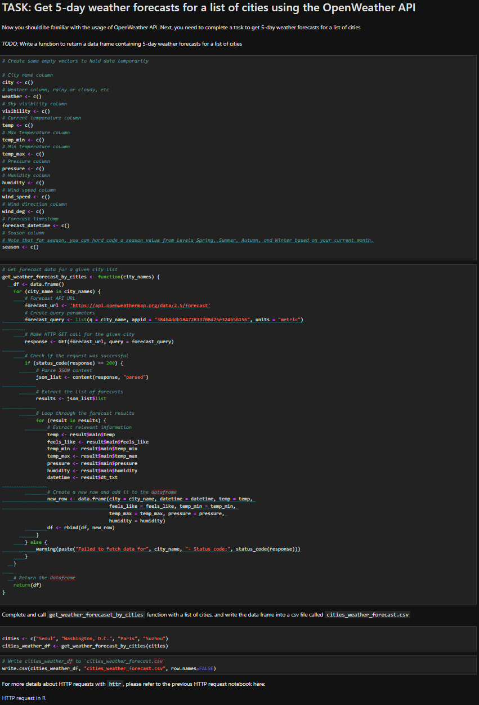
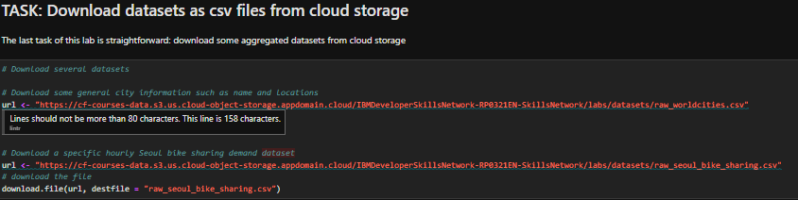
Appendix: OpenWeather API

Slide 38
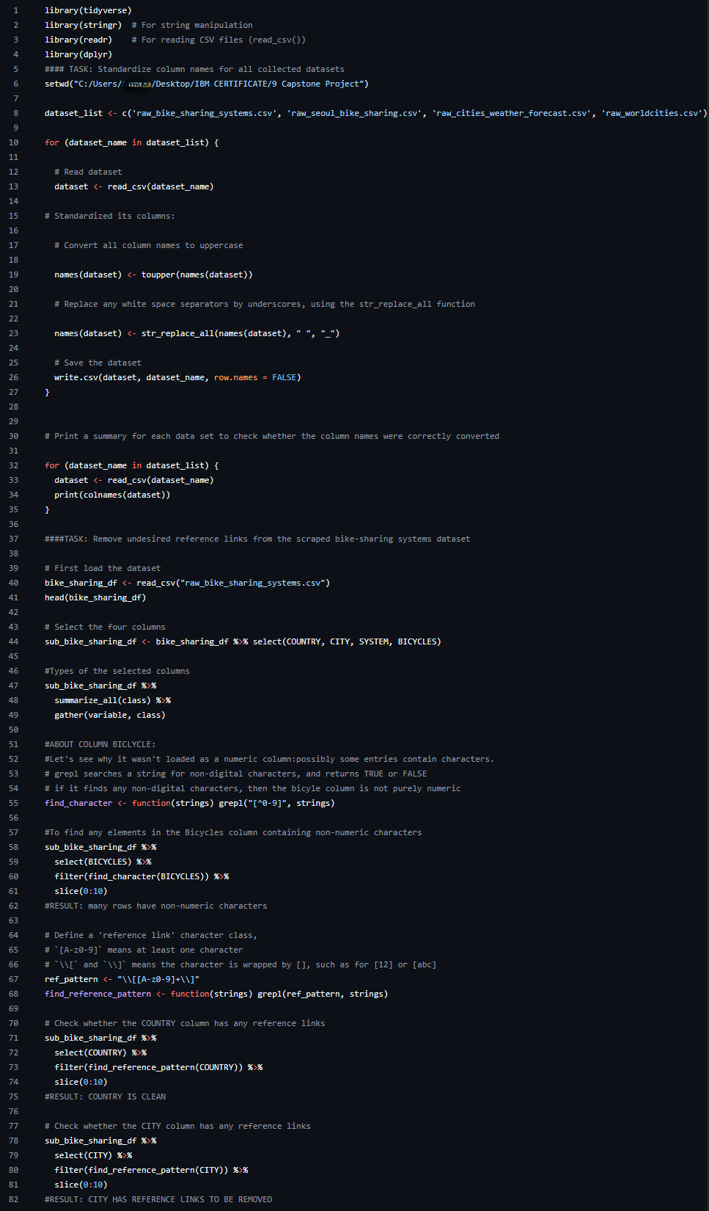
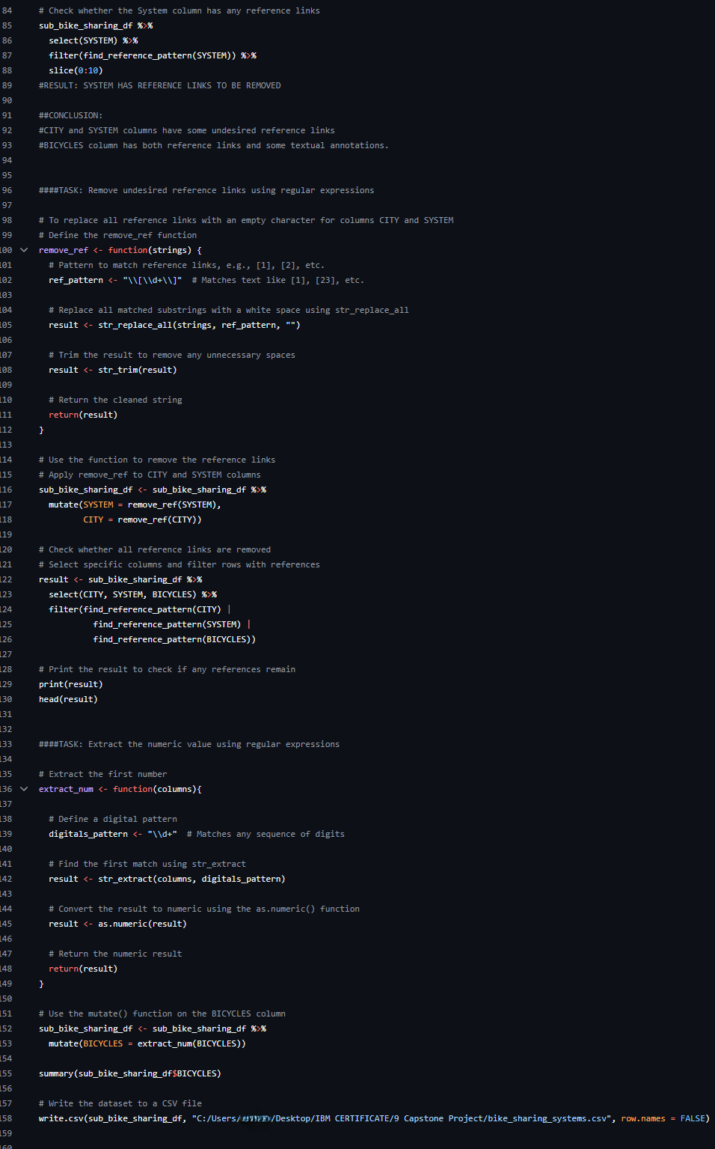
Appendix: Data Wrangling – Regular Expressions

Slide 39
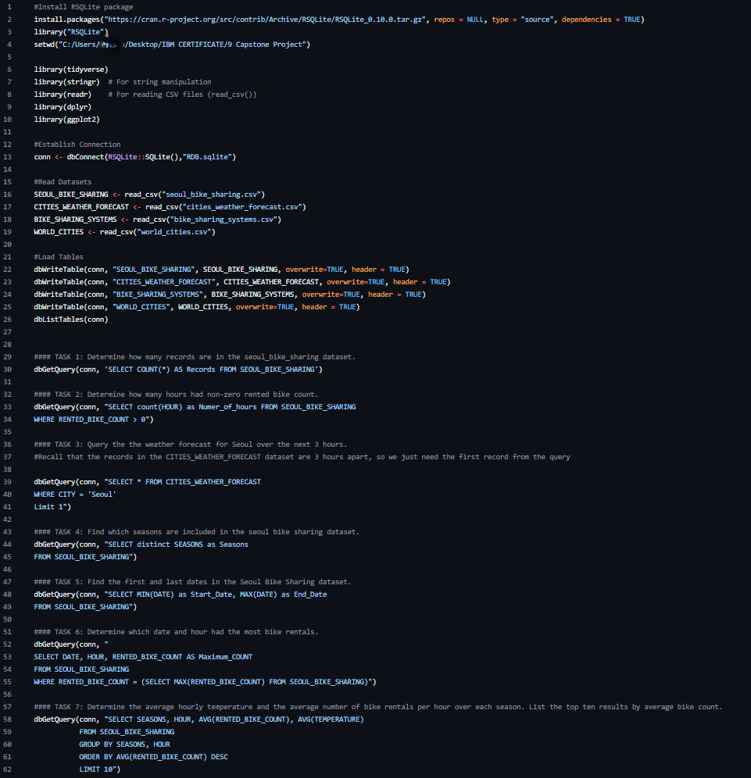
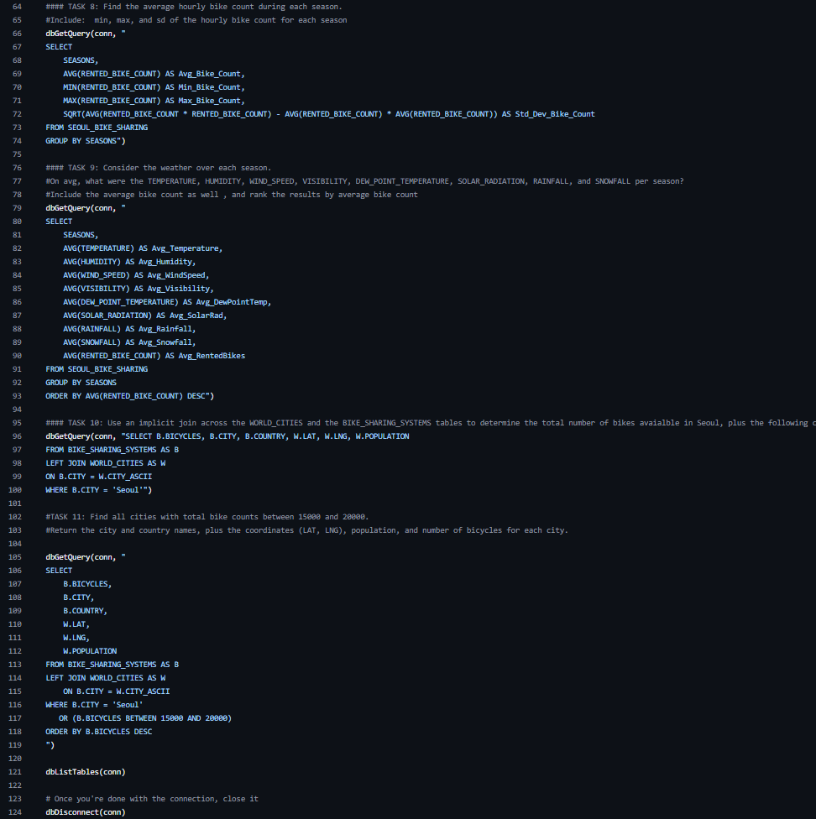
Appendix: EDA – SQL

Slide 40
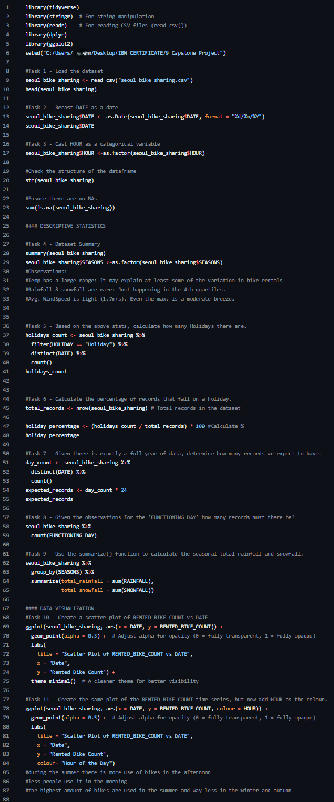
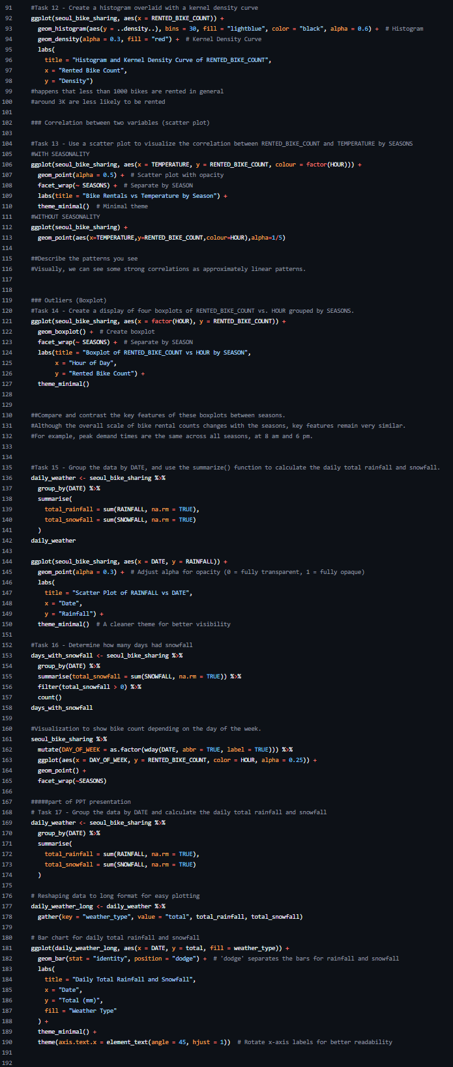
EDA with Visualizations

